Slide 1
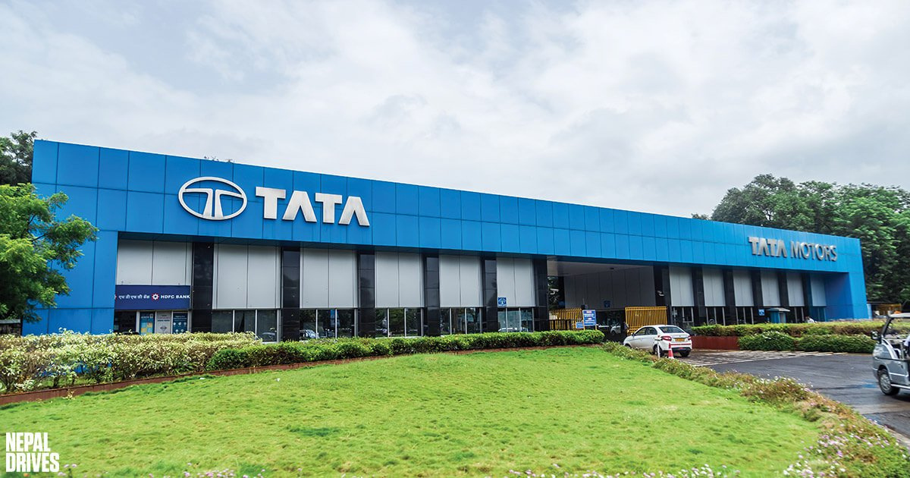
Digital Dashboard
HR-Skill Development Center
TMCV PUNE
Driving Skill Excellence through Digital Transformation
Presented by: Intern Pratik Gaikwad

Slide 2
Current Scenario (Manually work )
TNI Capturing
Target data analysis
Monthly Calendar Plan and Scheduling
Paper based attendance convert in Excel
Paper based CIRO feedback convert in Excel
processing Plan Vs Actual training status
Various report preparation refer current coverage
Limited real-time visibility
Need refresh after every entry
Development Journey
Evolved Web application addressing current Challenges
Centralised MYSQL data base
Used Python as backend & Flask as frame work
Used HTML CSS and Bootstrap for front end
Used Chart.JS library to create interactive chart

Slide 3
Next Steps on the Horizon
Infrastructure & Hosting Setup – Establish stable, secure, and scalable environment.
Deployment Support – Follow company standards for proper deployment
Automated Email System – Enable alerts, reminders, and confirmations
Historical Data Integration – Incorporate past data into dashboard standards
Security & Data Protection – Ensure compliance and safeguard sensitive data

Slide 4
Thank you

Slide 5
Current Scenario (Manually work )
TNI Capturing
Target data analysis
Monthly Calendar Plan and Scheduling
Paper based attendance convert in Excel
Paper based CIRO feedback convert in Excel
processing Plan Vs Actual training status
Various report preparation refer current coverage
Limited real-time visibility
Need refresh after every entry
Development Journey
Understand end to end process of Capability development at TML
Study Current Data Management
Evolve Web application addressing current Challenges
Centralised MYSQL data base
Used Python as backend & Flask as frame work
Used HTML CSS and Bootstrap for front end
Used Chart.JS library to create interactive chart

Slide 6
Centralized Training Records
Improved Accuracy and Compliance
Audit Readiness and Reporting
Transparency and Process Streamlining
Training Needs Identification
Automated Scheduling
QR based attendance
QR based CIRO
End Users
CHRO
Plant Head
Corporate Skill Development Head
HR Head
Factory Head
Skill Head
Shop Floor Training Coordinators
PSD Team & Head
ER Officer
Admin
TNI &
Scheduling
Digital Documentation
DEMO
Feedback
Mechanism
Monitoring of
Performance
Continuous feedback loop
Instant feedback analytics
Data-driven improvement actions
Real-time KPI Tracking
Data-Driven Decision Making
Transparency and Accountability
Export-ready reports & smart filters

Slide 7
